Slide 1

Aplicaciones Web basadas en Servicios (AWS)
Taller W01 G3: Research Groups
Pedro Tejada De Los Santos
Willy De Los Santos Uribe
David Féliz Fernández

Slide 2

Application Programming Interface, is a set of applications, functions and procedures that offers a library to be used by other software as an abstraction layer.

Slide 3
Table of Contents
Objectives
Work done
Resource design
Effort analysis by member
Postman Tests
Travis CI Tests
API Demonstration
Conclusions
Acknowledgments

Slide 4
Objectives
Back end development
Front end development
API Tests

Slide 5

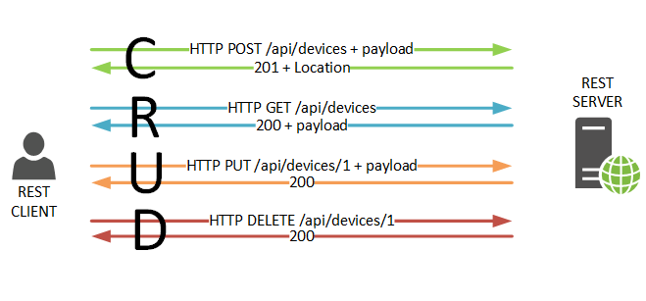
Work Done

Slide 6
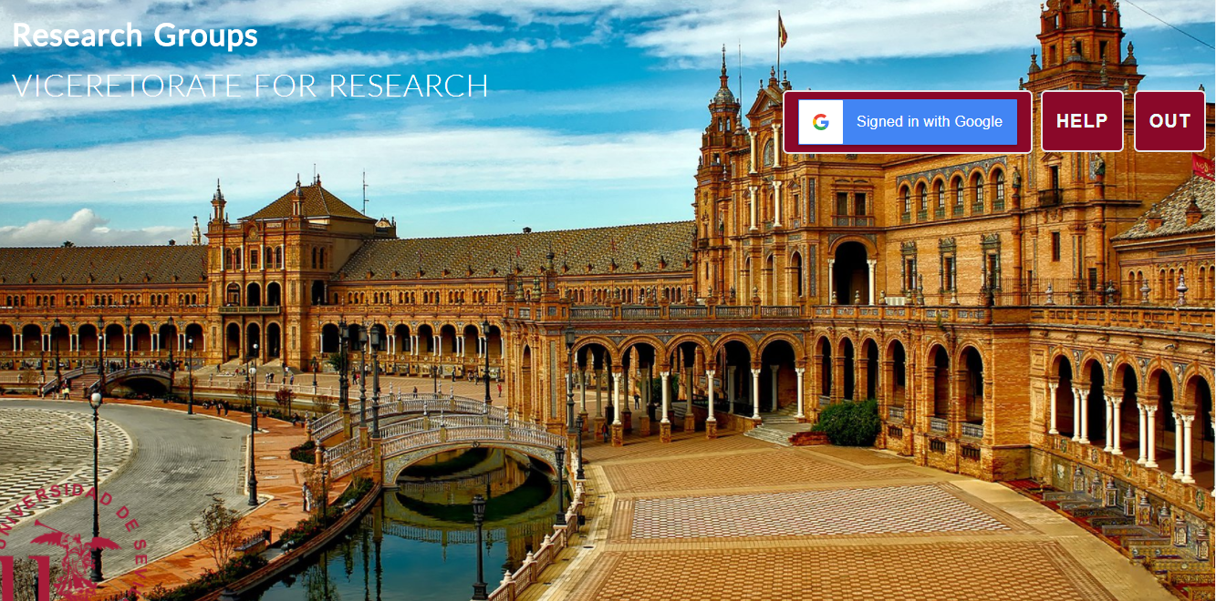
Home page

Slide 7
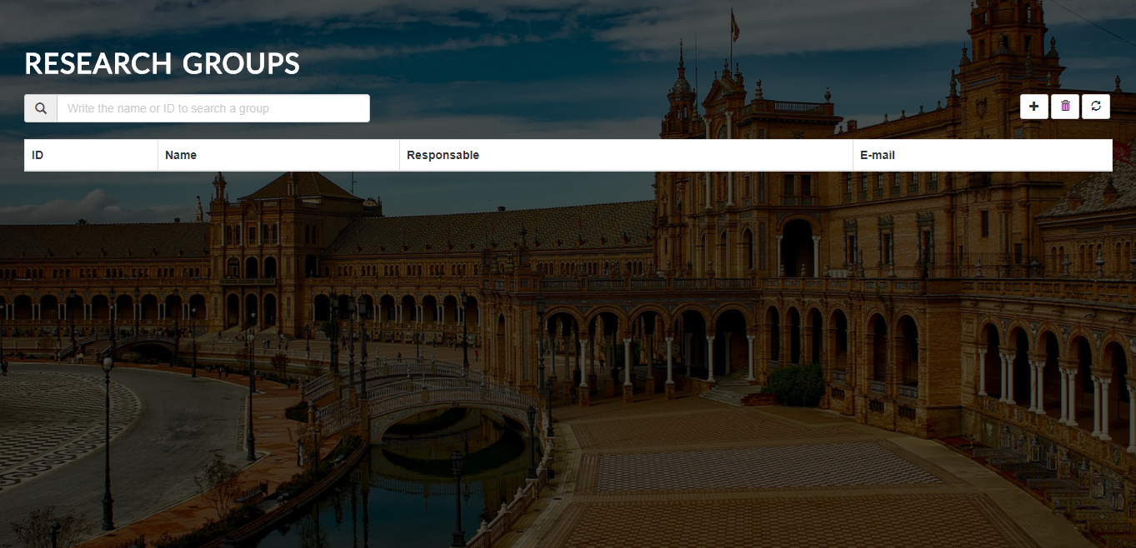
Guest view

Slide 8
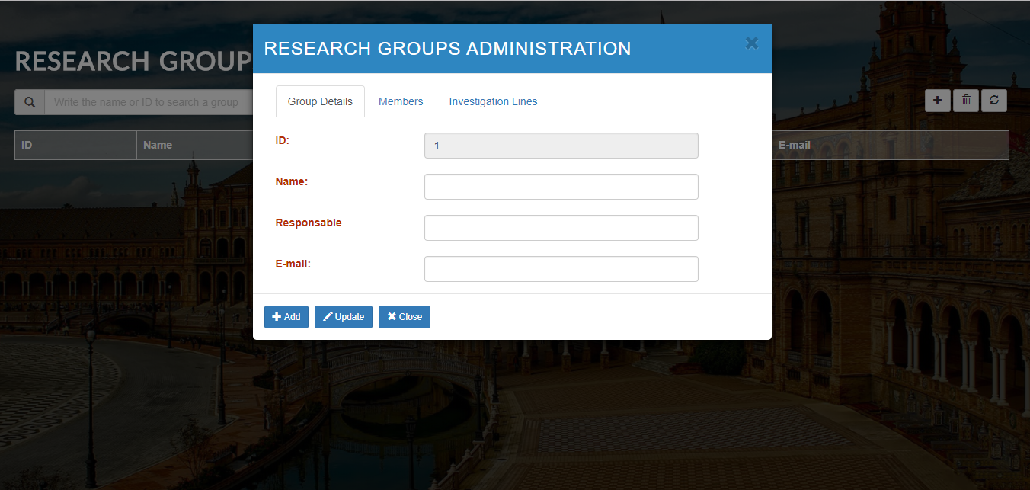
Research Groups

Slide 9
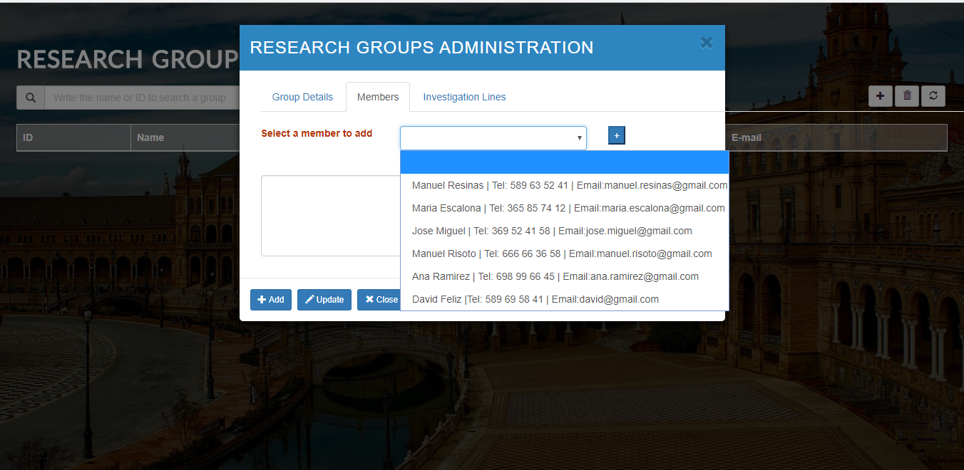
Research Groups

Slide 10
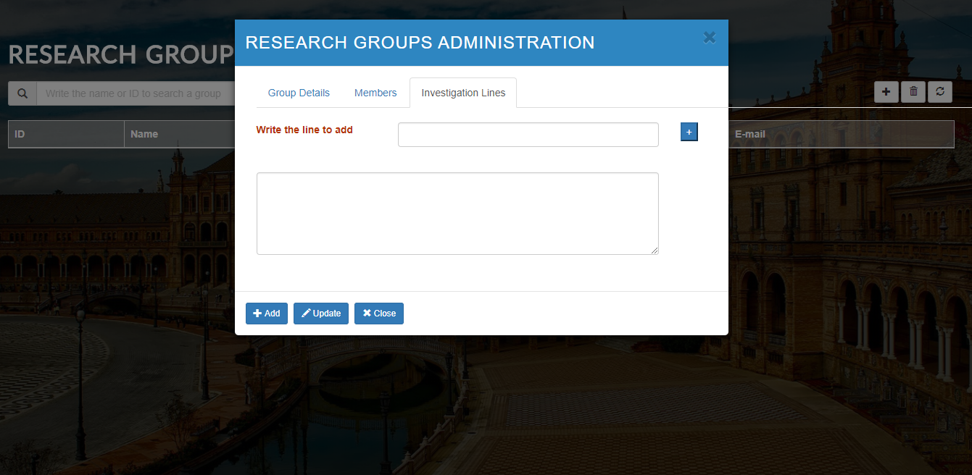
Research Groups

Slide 11
Effort analysis by member
Miembro | Horas diarias (promedio) | Horas semanales (promedio) | Horas Totales (promedio)
Pedro Tejada | 7 | 51 | 124
Willy De Los Santos | 7 | 51 | 124
David Féliz | 7 | 51 | 124

Slide 12
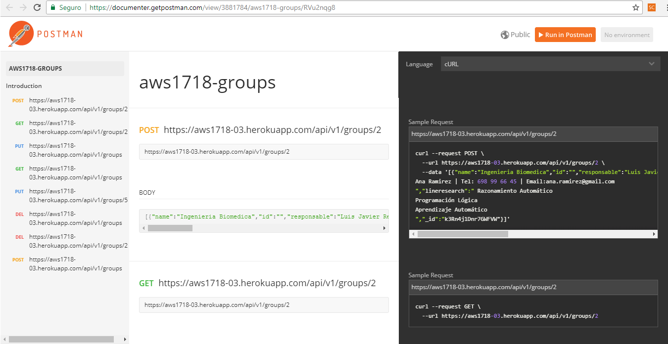
Postman Tests

Slide 13
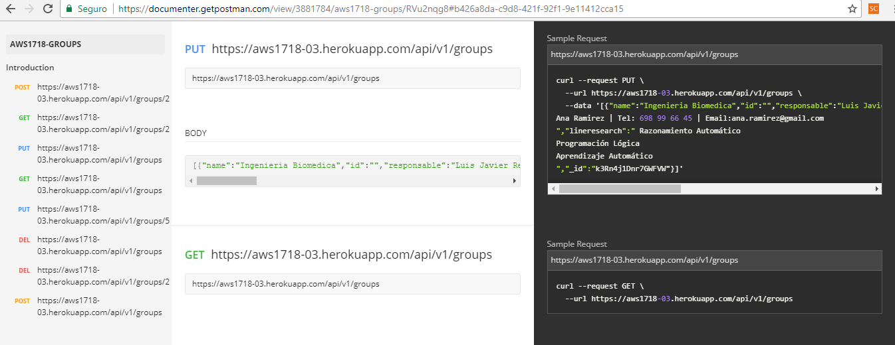
Postman Test

Slide 14
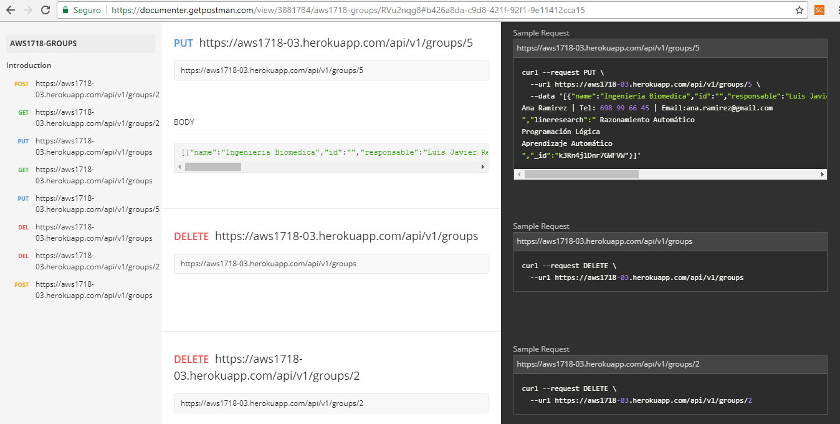
Postman Test

Slide 15
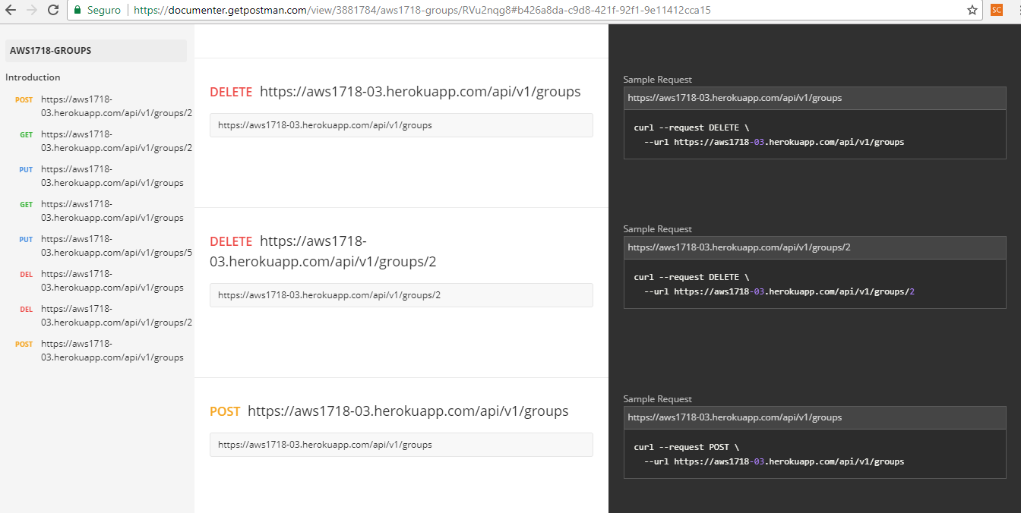
Postman Test

Slide 16
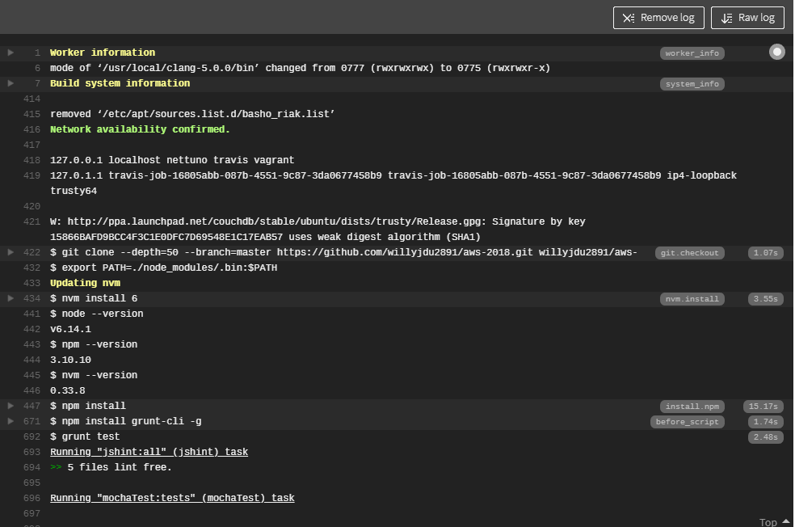
Travis CI Tests

Slide 17
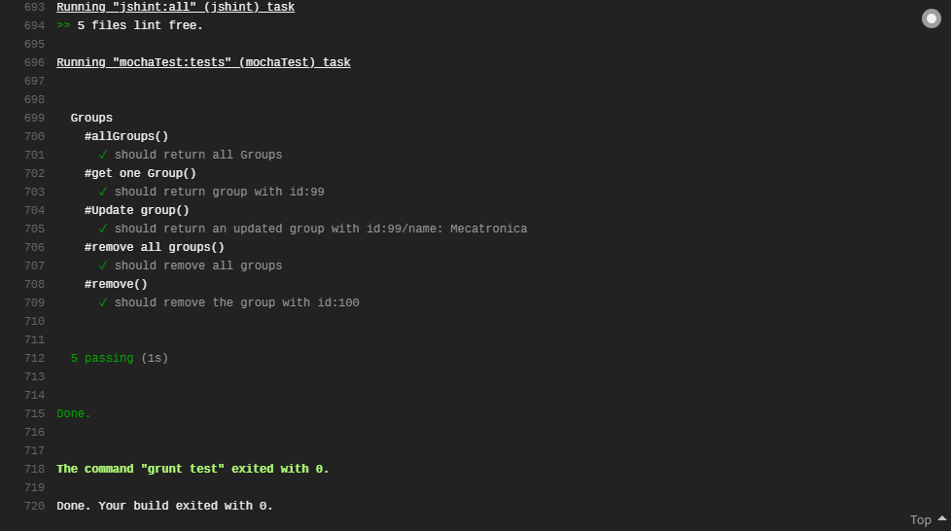
Travis CI Tests

Slide 18

API Demonstration

Slide 19


Conclusions and Learned lessons

Slide 20

Pedro Tejada pedtejde@alum.us.es
Willy De Los Santos wildeuri@alum.us.es
David Féliz davfelfer@alum.us.es

